Slide 1
ANDROID
Seminar at Prince of Songkla University
30 October 2010
Dr. Leons Kovisars

Slide 2
CREDENTIALS
B.S., Ph.D, M.B.A.
IBM System/360 in 1965
Stanford/SRI; Visiting Professor
Conoco, Chase Econometrics, Cargill
MET Research Corp.
Databases, financial modeling, time-series statistics/analysis, neural networks
Focus on mining and metal industries

Slide 3
OVERVIEW
Powerful mobile devices
      Capable of general-purpose computing;
      Will become the next PC
      Enormous base and growth
Google developed Android
      Linux kernel but becoming a fork
      Powerful free SDK and tools makes low to no-risk entry
      Support by Google, OEMs and telcoms
Android will be the mobile OS of choice
      OEM creates unit with best mobile OS
      Telcoms can customize
      User gets Android Marketplace, others shopping

Slide 4
BACKGROUND
Open Handset Alliance
    established on 5 November 2007
      10 mobile operators
      13 software companies
      15 semiconductor producers
      13 handset producers
      8 system integrators
First products
    Android SDK on 12-Nov-2007
    First handset HTC Dream 22-Oct-2008

Slide 5
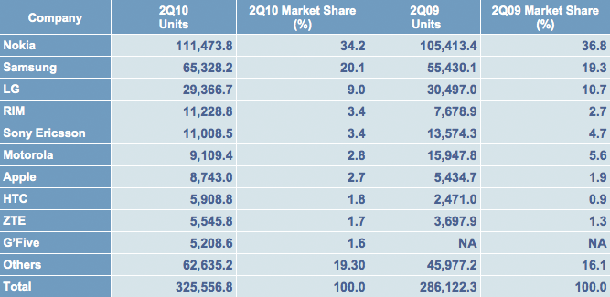
WORLDWIDE MOBILE DEVICES SALES
1000
1000
Growth = 13.8%

Slide 6
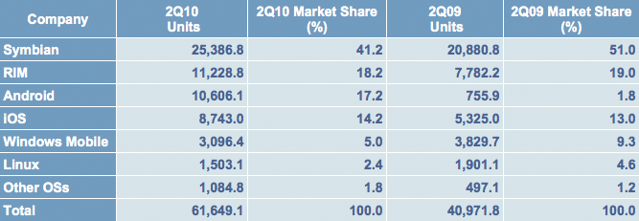
WORLDWIDE SMARTPHONE SALES
1000
1000
Growth = 50.5%

Slide 7
ANDROID FAST GROWTH
During 2Q2010
    Android share grows to 17% from 12%
    Microsoft share declines 2.2%
    RIM share declines 1.8%
    Apple share declines 1.3%
      Iphone 4 launched in June
Android share of smartphone market forecast to rise to 24.6 percent between 2010 and 2014.

Slide 8
DEVELOPER VIEWPOINT
Market Opportunity
    Current strong market position
      Favorable press, reviews, user comments
  High growth expectations
Development Support
  Google
  Device OEMs (Samsung, HTC, Motorola, etc.)
  Telcoms
      Worldwide: Sprint, Vodafone, NTT, China Mob, etc.
      Thailand: True, AIS, etc.
Community And Users

Slide 9
WHAT MAKES ANDROID SPECIAL?
Truly open, free development platform
      Linux based
Component-based architecture
      Reusable, replaceable modules
Multi-layer isolation of programs
Many services included
      High quality graphics and sound
Portability across hardware
      Java programs executed by Davlik virtual machine
      ARM, x86 and other
Support by multiple large organizations

Slide 10
OPEN SYSTEM
Andy Rubin, VP of Engineering @ Google on 19-Oct-2010 on Twitter:
The definition of open:
‘mkdir android ; cd android ; repo init -u git://android.git.kernel.org/platform/
manifest.git ; repo sync ; make’

Slide 11
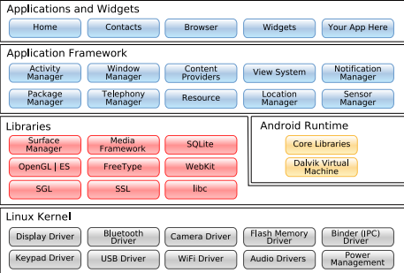
ANDROID SYSTEM ARCHITECTURE

Slide 12
ANDROID APP COMPONENTS 1
Activities
      An activity is a core component of the Android platform. Each activity represents a task the application can do, often tied to a corresponding screen in the application user interface.
Content providers
      Data stored on the device which can be used by multiple applications. The Android model makes it easy to make this data available to your own applications as well as others. An example is the content provider for contacts with the contained names, addresses, phone numbers, etc. available to any application.

Slide 13
ANDROID APP COMPONENTS 2
Services
    Tasks that run in background without the user’s direct interaction. An example would be music playing while the user is on another program. Another activity may bind to that service to switch tracks, all in the background.
Intents
    System messages notifying activities of various events eg. memory stick inserted, file download completed, activity launched from menu. Intents can be created to give status reports such a how much of file is copied or warnings eg. left turn at next intersection.

Slide 14
DEVELOPMENT FEATURES 1
Multimedia
    Audio and video playback and record ability will be native in the devices. Interrogate these and use as desired eg. video recording, music playback, microphone for audio notes.
Network
    Most Android devices will be Internet ready. The net can be accessed at any desired level, from Java sockets to the integral WebKit-based web browser which can be embedded into your apps.

Slide 15
DEVELOPMENT FEATURES 2
Storage
Global positioning system (GPS)
    Many devices will have GPS receiver to dtermine location. This location data can be used in navigation as well as triggering activities.
Phone services
    All phone services eg. Initiate and receive calls, short messages, data transmittals

Slide 16
KEY TOOLS
Linux, Windows, Mac OSX
Java (Oracle/Sun)
  Java SDK 6 update 22
SDK (Google)
  Android SDK r7
Eclipse
  Eclipse 3.6.1

Slide 17
APPLICATION
Devices
    Phones
    Tablets
    Netbooks
    Embedded and control units
Apps

Slide 18
IMPLEMENTATION
Cheap: Install the tools
    Java, Eclipse, Android SDK
      Your computer: Windows, Linux, Mac
    Phone emulator included
Easy: Create your first program
    Android Development Toolkit (ADT)
      Plugin for Eclipse, written by Google
    Examples and tutorials available
    Run on the Emulator
    Verify by USB connecting a phone to computer
Rewarding: Prepare to publish eg. Google Market

Slide 19

SOFTWARE DEVELOPMENT
Design
Testing
No
Design
Error?
Errors?
Yes
Yes
Release Process
No

Slide 20
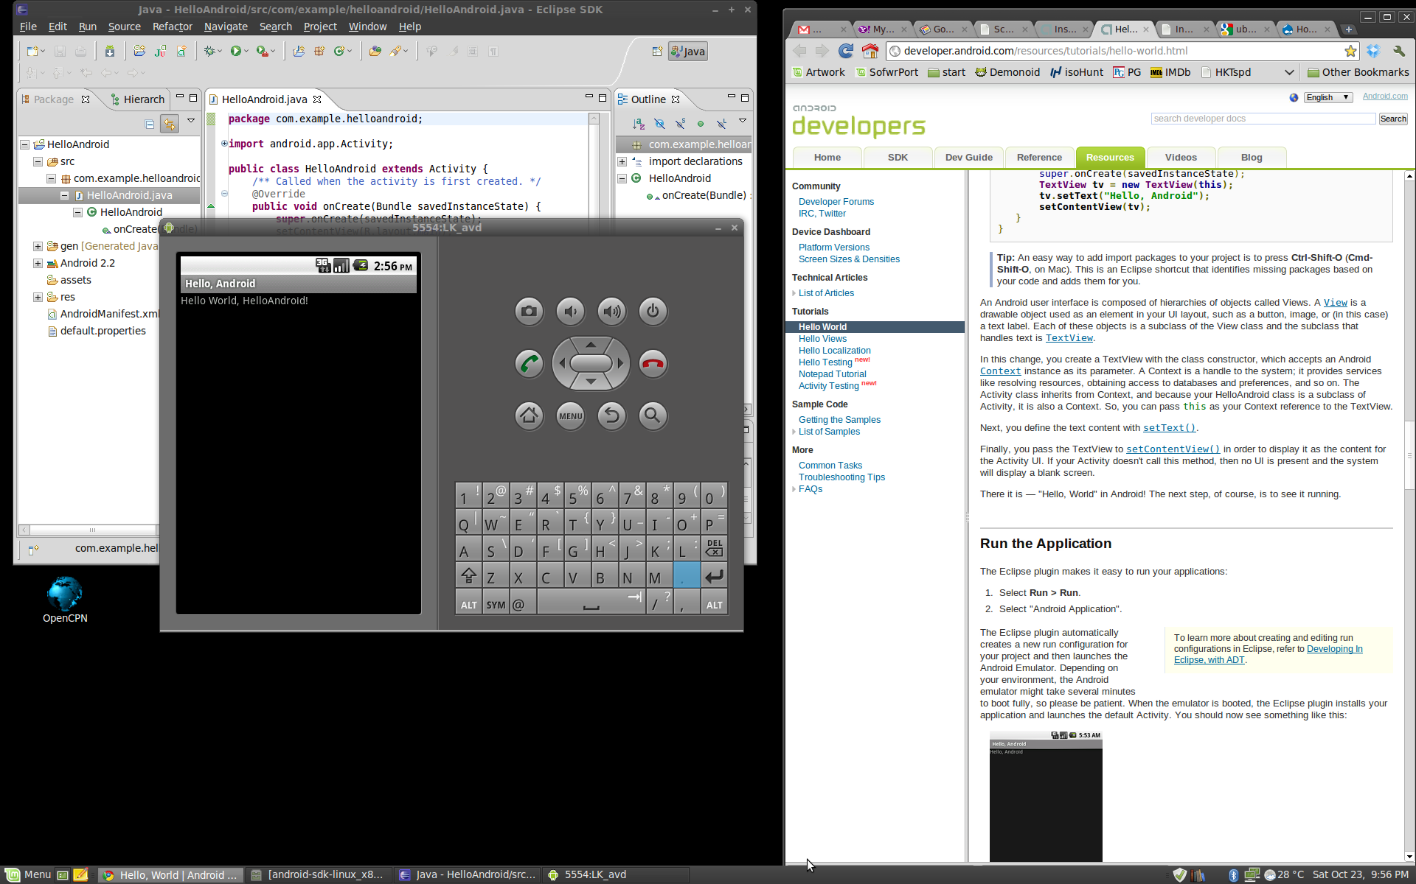
ECLIPSE WITH EMULATOR

Slide 21
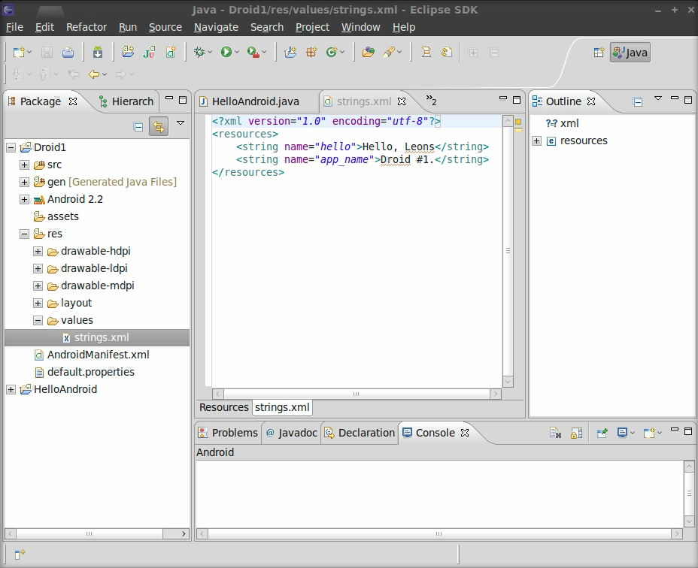

Slide 22
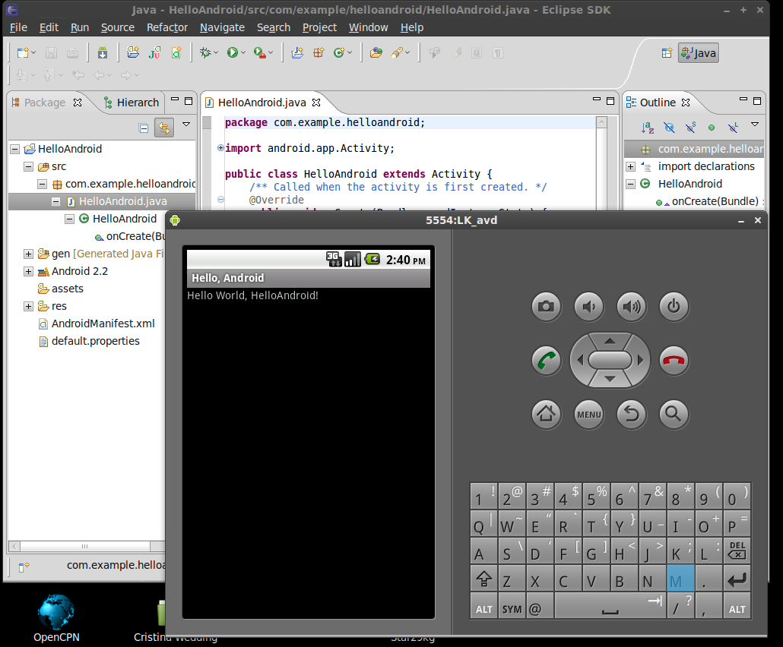
ECLIPSE WITH EMULATOR

Slide 23
RELEASE PROCESS
Prepare for Build
Perform Build
“Release Candidate”
Thoroughly
Test Build
Got Bugs?
Fix Bugs!
Got Bugs?
No Bugs?
Publish
Release
Test Packaged
Release Candidate
Package and
Sign Package

Slide 24
APP INVENTOR
Googlelab development
No developer experience needed
Create functional flowsheet
Assemble modular blocks
Final product can be sold on Android Market

Slide 25
ONLINE ANDROID RESOURCES
Android developer website
    http://developer.android.com
Open Handset Alliance
    http://www.openhandsetalliance.com
Android Market
    http://market.android.com/publish
Android libraries and extensions
    http://openintents.org
Android developer forum
    http://www.anddev.org

Slide 26
OUTLOOK
Android will continue rapid growth
      Expected to be #1 smartphone by 2014
Handsets will be major market
      tablets and netbooks significant fringe
Google will guide but not rule Android
      Telcos want to differentiate and have image
      Telcos want to lock users
      Telco aims conflict with developers and update process
      Google is expected to impose more uniformity
        System minimum requirements
        GUI design

Slide 27
SUMMARY
Solid, proven, popular, open platform
Used on wide range of devices
Support from Google, OEMs, telcoms
Low barriers to entry
Major opportunity for new developers
Creativity, hard work, persistence

